Slide 1
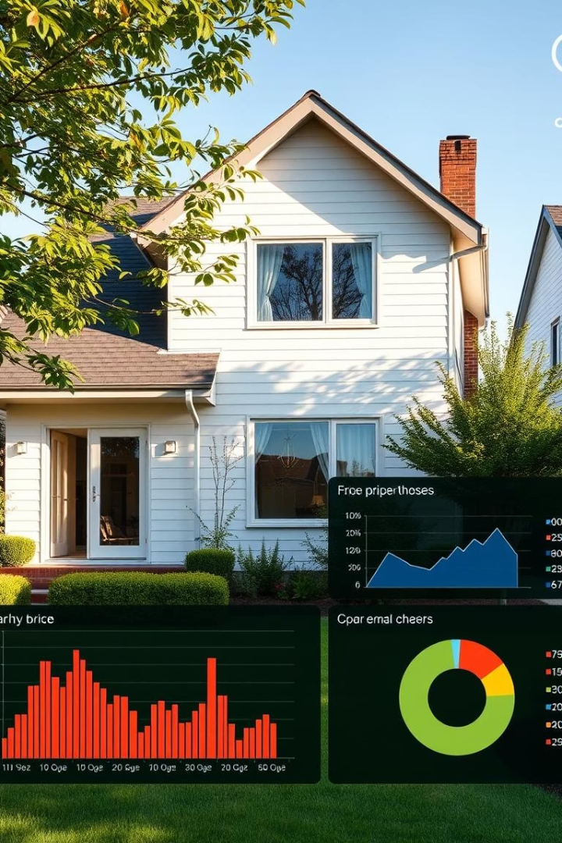


SmartHouse: Predictive Analytics for House Prices
A data-driven project using Python to predict house prices. Explore dataset, preprocessing, and modeling insights.
by Abhishek Jha

Slide 2
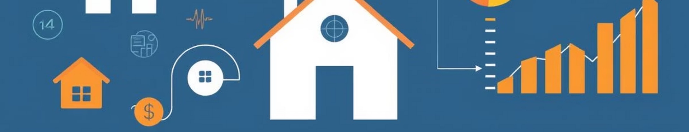
Project Objective
Price Prediction
Data Processing
Machine Learning
Forecast house prices based on key features like crime rate and rooms.
Clean and prepare data for improved model accuracy.
Apply ML models to enhance prediction performance.

Slide 3

Dataset Overview
Source
Target Variable
Boston Housing Dataset with 506 rows and 14 columns.
Median value of homes (medv) used for price prediction.
Features
Includes crime rate, average rooms, property age, tax, and others.

Slide 4
Data Preprocessing
Missing Values
Feature Selection
Normalization & Encoding
Dataset contains no missing values, ensuring data integrity.
Unimportant features were removed to reduce noise and improve model focus.
Features normalized; categorical data encoded via Label Encoding.

Slide 5
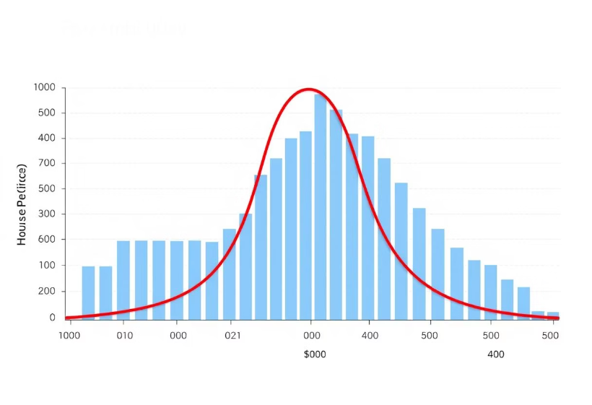
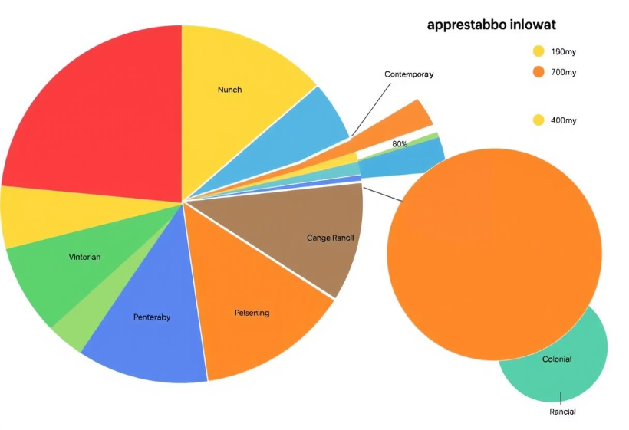
Exploratory Data Analysis (EDA)
Histogram reveals price distribution and range.
Pie chart displays distribution of 'chas' categorical variable.

Slide 6




Model Building
Models Used
Train-Test Split
Linear Regression and Random Forest Regressor applied.
80/20 split ensures balanced training and testing sets.
Tools
Python libraries: sklearn, pandas, matplotlib, seaborn.

Slide 7
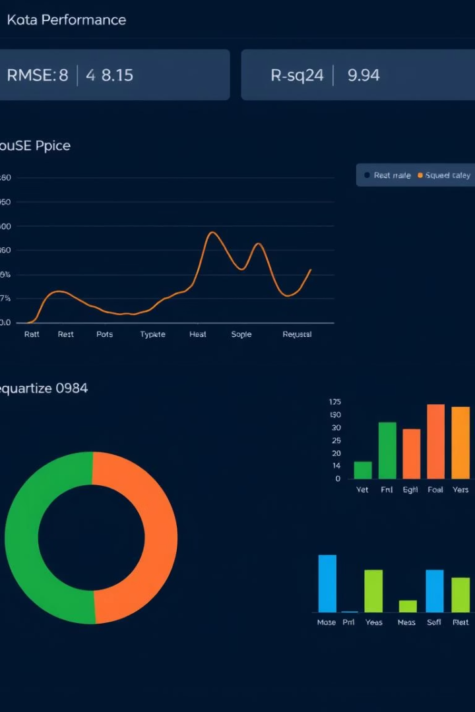
Model Evaluation
Model
RMSE
R² Score
Linear Regression
X.XX
X.XX
Random Forest
X.XX
X.XX

Slide 8
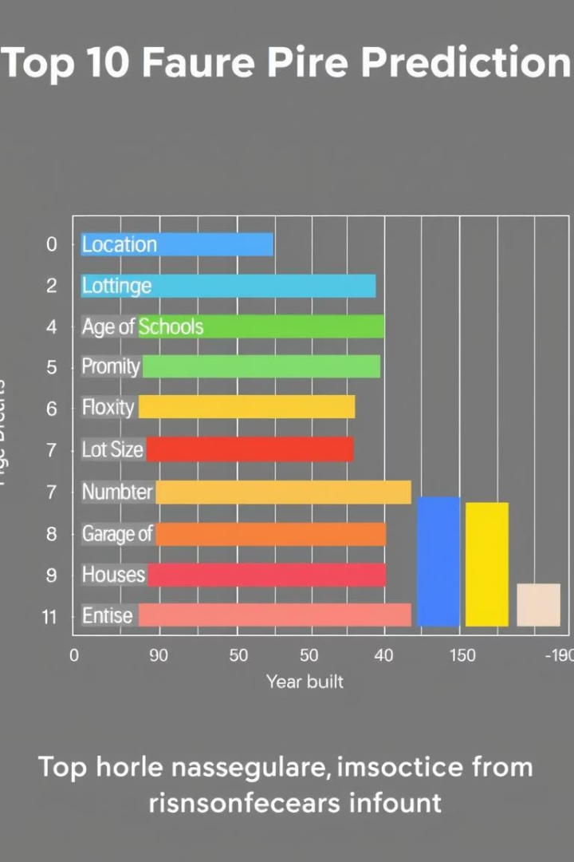
Feature Importance
Random Forest highlights strongest predictors of house prices.

Slide 9




Conclusion & Future Work
Accurate Predictions
ML models effectively forecast house prices.
Data Insights
Cleaned and visualized data improved understanding.
Next Steps
Explore deep learning and app deployment.

Slide 10

GitHub & Thank You
🔗 GitHub Repo: https://github.com/CodeByAbhishek404/smart-house-price-predictionh
🙏 Thank you for your attention!
Questions are welcome.

